Slide 1


Slide 2
Welcome to the Year 12
Information and Curriculum Evening
Notes:
RM

Slide 3
Ms Sheppard – Head of Sixth Form
Mr Smith – Deputy Head of Sixth Form
Mr Bevan – Head of Year 12
Mrs Wilson - Head of Year 13
Mrs Thompson – Sixth Form Lead Administrator
Notes:
RM

Slide 4
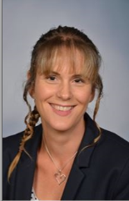
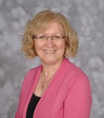
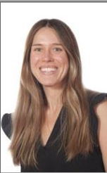
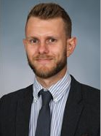
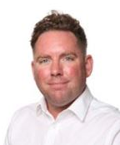
Sixth Form Leadership
Notes:
RM

Slide 5
Content for the evening
1. Curriculum
2. Wider curriculum
3. Day to day routines
4. Key dates and key information
Notes:
RM

Slide 6
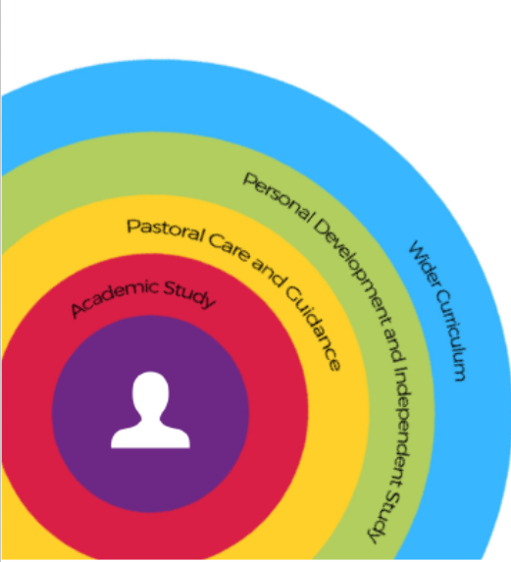
The Sixth Form Curriculum
Timetable
Subject Choices
Notes:
HS

Slide 7
What is in a timetable?
Core programme of 3 subjects (A level or equivalent)
Extension study (Year 12 only)
Tutor Time
Assembly hour
Specialist Tutor Time
Wednesday Afternoon Activities (SFE)
Work experience and/or volunteering
Notes:
TH

Slide 8
A Sixth Former’s Daily Routines
 | 1Mon | 1Tue | 1Wed | 1Thu | 1Fri | 2Mon | 2Tue | 2Wed | 2Thu | 2Fri
Morning Registration (8.35-9.00)
Period 1 |  | Sociology | Law | Law | Law | Core Maths |  | Psychology | Law | Law
Period 2 | Sociology | Law | Psychology |  |  |  | Law |  | STP | Psychology
Break time (11.00-11.20)
Period 3 | Assembly | Psychology | Sociology |  | Psychology | Psychology | Sociology | Sociology
Period 4 | Law | Core Maths |  | Sociology | Sociology |  | Psychology | Psychology | Psychology | Sociology
Lunchtime (1.20-2.05)
Period 5 | Core Maths |  | Sixth Form Enrichment |  | Law | Psychology | Sociology | Sixth Form Enrichment | Core Maths
Notes:
LIS

Slide 9
A Sixth Former’s Daily Routines
 | 1Mon | 1Tue | 1Wed | 1Thu | 1Fri | 2Mon | 2Tue | 2Wed | 2Thu | 2Fri
Morning Registration (8.35-9.00)
Period 1 |  | Sociology | Law | Law | Law | Core Maths |  | Psychology | Law | Law
Period 2 | Sociology | Law | Psychology |  |  |  | Law |  | STP | Psychology
Break time (11.00-11.20)
Period 3 | Assembly | Psychology | Sociology |  | Psychology | Psychology | Sociology | Sociology
Period 4 | Law | Core Maths |  | Sociology | Sociology |  | Psychology | Psychology | Psychology | Sociology
Lunchtime (1.20-2.05)
Period 5 | Core Maths |  | Sixth Form Enrichment |  | Law | Psychology | Sociology | Sixth Form Enrichment | Core Maths
Notes:
LIS

Slide 10
A Sixth Former’s Daily Routines
 | 1Mon | 1Tue | 1Wed | 1Thu | 1Fri | 2Mon | 2Tue | 2Wed | 2Thu | 2Fri
Morning Registration (8.35-9.00)
Period 1 |  | Sociology | Law | Law | Law | Core Maths |  | Psychology | Law | Law
Period 2 | Sociology | Law | Psychology |  |  |  | Law |  | STP | Psychology
Break time (11.00-11.20)
Period 3 | Assembly | Psychology | Sociology |  | Psychology | Psychology | Sociology | Sociology
Period 4 | Law | Core Maths |  | Sociology | Sociology |  | Psychology | Psychology | Psychology | Sociology
Lunchtime (1.20-2.05)
Period 5 | Core Maths |  | Sixth Form Enrichment |  | Law | Psychology | Sociology | Sixth Form Enrichment | Core Maths
Notes:
LIS

Slide 11
Wider Curriculum
 | 1Mon | 1Tue | 1Wed | 1Thu | 1Fri | 2Mon | 2Tue | 2Wed | 2Thu | 2Fri
Morning Registration (8.35-9.00)
Period 1 |  | Sociology | Law | Law | Law | Core Maths |  | Psychology | Law | Law
Period 2 | Sociology | Law | Psychology |  |  |  | Law |  | STP | Psychology
Break time (11.00-11.20)
Period 3 | Assembly | Psychology | Sociology |  | Psychology | Psychology | Sociology | Sociology
Period 4 | Law | Core Maths |  | Sociology | Sociology |  | Psychology | Psychology | Psychology | Sociology
Lunchtime (1.20-2.05)
Period 5 | Core Maths |  | Sixth Form Enrichment |  | Law | Psychology | Sociology | Sixth Form Enrichment | Core Maths
Notes:
LIS

Slide 12
Extended Curriculum
 | 1Mon | 1Tue | 1Wed | 1Thu | 1Fri | 2Mon | 2Tue | 2Wed | 2Thu | 2Fri
Morning Registration (8.35-9.00)
Period 1 |  | Sociology | Law | Law | Law | Core Maths |  | Psychology | Law | Law
Period 2 | Sociology | Law | Psychology |  |  |  | Law |  | STP | Psychology
Break time (11.00-11.20)
Period 3 | Assembly | Psychology | Sociology |  | Psychology | Psychology | Sociology | Sociology |  | Core Maths
Period 4 | Law | Core Maths |  | Sociology | Sociology |  | Psychology | Psychology | Psychology | Sociology
Lunchtime (1.20-2.05)
Period 5 | Core Maths |  | Sixth Form Enrichment |  | Law | Psychology | Sociology | Sixth Form Enrichment | Core Maths
Notes:
LIS

Slide 13
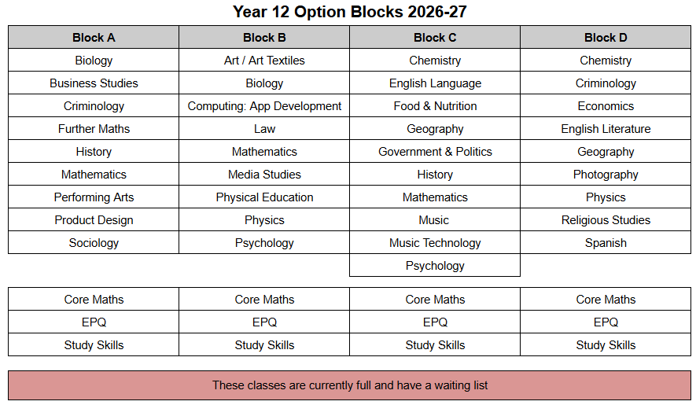
Subject Choices
A levels, AAQs, BTECs, CTECS
Is it too late to change?
Notes:
TH

Slide 14
Entry Criteria and Option Blocks
Notes:
HS

Slide 15
Extended Curriculum Options
CORE CONCEPT | EPQ (EXTENDED PROJECT) | CORE MATHS | STUDY SKILLS | 4TH A-LEVEL
What is it? | An independent research project on a topic of your choice, resulting in an essay or artifact. | A practical, real-world math course focused on personal finance, data analysis, and estimation. | A lesson of taught study skills and a lesson of supervised study per fortnight. | A full fourth academic subject studied alongside the standard 3 A-Level subjects.
Hours per Fortnight | 3 Hours (highly self-directed with light mentorship). | 5 Hours (fully taught classroom lessons). | 2 Hours (1 taught, 1 supervised lesson). | 9 Hours (fully taught classroom curriculum).
Qualification Size | Equivalent to 0.5 A-Level (Graded A–E, awards up to 28 UCAS Tariff points)* | Equivalent to an AS-Level (Graded A–E, awards up to 20 UCAS Tariff points / ~40% of an A-Level in UCAS points) | Does not provide a qualification (0 UCAS Tariff points) | Equivalent to 1.0 A-Level (Graded A–E, awards up to 56 UCAS Tariff points)*
Extension Purpose | Proves university-level research skills. Often results in lowered grade offers from universities. | Maintains quantitative skills to support other courses (e.g., Psychology, Geography, Biology). | Helps students learn essential study skills as they make the step up from GCSE to A-Level, helping develop independence. | Demonstrates massive academic breadth, but is very rarely valuable for next steps - not recommended. .
Notes:
TH - students

Slide 16
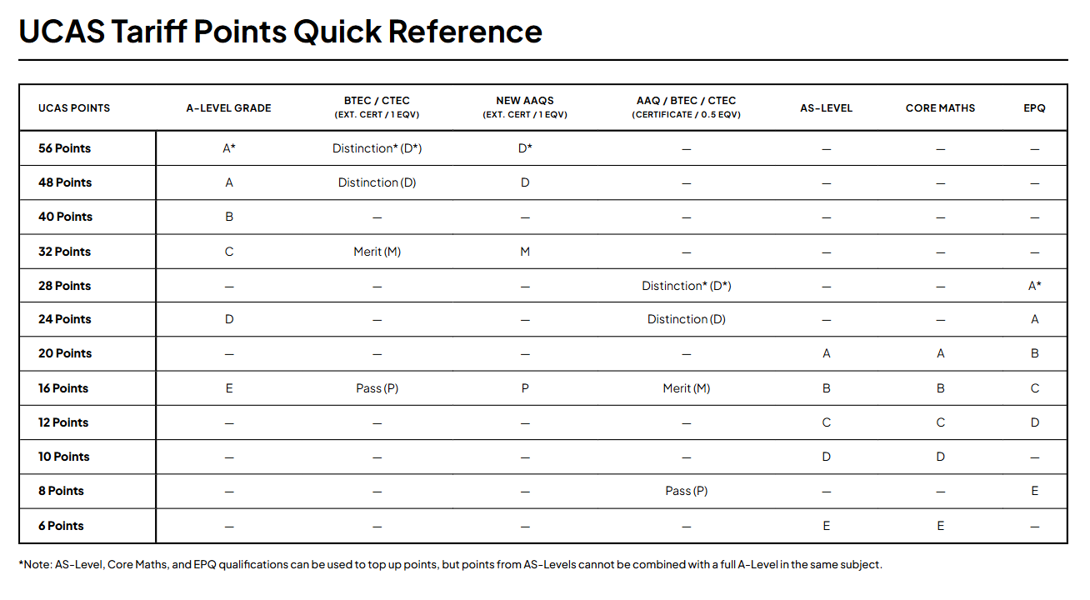
Notes:
TH

Slide 17
2. The Sixth Form Wider Curriculum
Specialist Tutor Programme
Trips and Visits
Wednesday afternoon options
Volunteering and Work Experience
Extra-curricular activities
Super-curricular activities
Notes:
HS

Slide 18

The Specialist Tutor Programme
Notes:
LIS

Slide 19
Every other Thursday (Week 2, Period 2)
Activities for the week are published every Monday.
Aims:
To provide specialist support, advice and guidance through a programme of activities that are tailored to the Personalised Curriculum.
Super-curricular learning
Aspirational encounters
Projects and activities that develop skills and competencies
Life-skills and personal development
Study skills and academic support
Notes:
LIS

Slide 20
Theme | Tutor | Tutor Initials
Business, IT, Law and Economics | Mrs Turner & Mrs Whiteley | 12ZT
English / Media | Ms H Smith & Mr Grimmett | 12HLS
Food / Product Design / Creative | Mrs Dearn | 12LED
HUMS & Social Sciences | Dr Carpenter | 12RLC
Performance (Performing Arts, Music, Music Tech, Sports) | Mr Humphrey | 12MH
STEM | Ms J Smith | 12JS

Slide 21

Business, IT, Law & Economics,
(Mrs Turner & Mrs Whiteley)
Links to:
Law
Web design
Programming
Economics
Finance
Business
Events management

Slide 22

English / Media
(Ms Smith & Mr Grimmett)
Links to:
English Language / Literature
Media
Film
Journalism
Law
Teaching
Marketing
Advertising

Slide 23

Food / Product Design / Creative
(Mrs Dearn)
Links to:
Food Technologists
Nutritionists, Dieticians
Butchers, Chefs
Marketing Managers
Environmental Health Officers
Architect
Illustrator
Interior Designer
Landscape Architect
Graphic Designer
Animator
Floristry

Slide 24

Hums & Social Sciences
(Dr Carpenter)
Links to:
Geography
History
Languages
Philosophy
Psychology
Health and Social Care
Criminology
Sociology
History
Archaeology
Sociology
Politics
Law
Philosophy
Ethics

Slide 25

Performance
(Mr Humphrey)
Links to:
Performing Arts
Music
Nutrition
Hospitality
Technology
Sports
Sports coaches and Fitness

Slide 26

STEM
(Ms Smith)
Links to:
Medicine
Dentistry
Veterinary
Biomedical Science
Health care
Maths
Finance
Analytics
Architecture
Energy
Animal Science Science
Physiotherapy and Sport Science
Forensic Science
STEM… and all Science pathways

Slide 27
STP Activity Examples
Speaker: Wildlife Film Making | What is a mortgage? | Environmental Action Group | Drama School Audition Prep
Uni Lecturer: Political Communications | Speaker: Apprenticeships in Accountancy | How to create effective study skills | Cooking for the homeless
Guest speaker: BIMM | Basic Aramaic | Oxbridge and Russell Group Prep | Making Music for TV
Grill a Vicar! | Alumni talk: Natural Sciences | How to build a portfolio | Understanding Freud
Prosthetics and make-up for Film | Personal Statement writing | First Aid | Plant propagation
Biomedical Engineering Event | Falmouth Uni: preparing for creative interviews | Bicycle maintenance | How to manage stress and workload
Notes:
LIS

Slide 28
STP Activity Examples
Cognitive Psychology and AI | Black History - Jennifer Eberhardt, understanding bias | Disaster planning: climate crisis | Political Party visits e.g. Green Party
Uni Lecturer: Political Communications | Planning your gap year | Civil Engineers CITYZEN competition | Book club
Positive masculinity | Mastering presentation skills | TaskMaster: problem solving skills | Prosthetics and make-up
Ethics of cloning | Alumni talk: Natural Sciences | Stage Production Skills | Wire Sculptures
Composing for film and TV | What is Post-Modernism? | Understanding Tax | Business and sustainability
Wealth Management | Robotics | Astrophysics | Calligraphy
Notes:
LIS

Slide 29

Apprenticeship providers
Employers
HE/FE
HE+ (Oxbridge Prep)
Volunteers
Academics
Can you help?
STP speakers

Slide 30
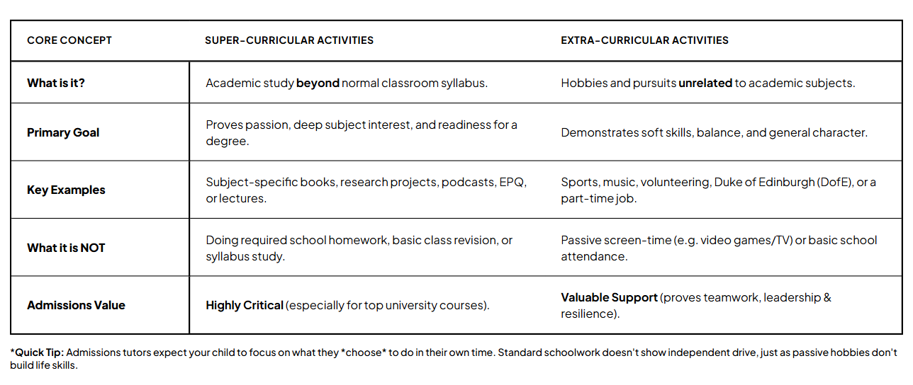
Super-curricular learning
Notes:
TH

Slide 31



Super-curricular learning
Watch films in the language you’re studying If you find it hard at first, you could watch with English subtitles to begin with. | Start a blog about your subject. | Watch Podcasts and videos https://podcasts.ox.ac.uk/ https://www.ted.com/
TED talks. A good place to start are ted talks recommended by students for students. https://www.weareteachers.com/ted-talks-students/ |  | Staircase 12 is hosted by Oxford University and has lots of ideas to help students extend their knowledge beyond the school syllabus. https://www.univ.ox.ac.uk/applying-to-univ/staircase12/
(Unifrog has a tool to help you find one) | Work experience and volunteering | Wider reading
Notes:
https://www.undergraduate.study.cam.ac.uk/files/publications/super-curricular_suggestions.pdf
https://www.ashmoleacademy.org/page/?title=Super%2DCurricular+Activities&pid=725
https://www.univ.ox.ac.uk/applying-to-univ/explore-your-subject/
https://www.ox.ac.uk/admissions/undergraduate/increasing-access/ug-digital-resources
https://academic.oup.com/pages/very-short-introductions

Slide 32
Work Experience
Students are expected to complete at least one week of work experience in Year 12.
Time is ‘allocated’ in Term 6 for Year 12 work experience - students are to complete 5 days of WEX between the 12-23rd July.
The time can be ‘part- exchanged’ for a different time of the year if it is more convenient. For example every Wednesday afternoon or a week in the Easter holidays or a week in the summer holidays.
Students will need to have their placement found, checked and logged. Students should start researching as soon as possible.
The checking process is done on Unifrog, this ensures that the placement is suitable and correctly checked.
Notes:
TH

Slide 33
Arranging off-site placements and WEX
Once a WEX placement or volunteering activity has been added to unifrog the employer/placement will (automatically) be sent a form to complete with the full placement details.
This means we can check that the employer has Employer liability insurance.
Once the employer has completed their form the parent/guardian (as added by the student) will be sent an email by unifrog to review the placement details and give their consent (please check your SPAM!). This ensures the placement is safe and appropriate.
sixthformwex@churchill-academy.org
Notes:
TH

Slide 34


Volunteering
What is the Volunteering programme?
A programme all Year 12 students will take part in
Helps you gain experience to draw upon when making applications (E.g. UCAS & Apprenticeships)
Gives you the opportunity to gain wider experiences that will help your own personal development.
How does the process work?
Look through the PPT with your tutors during registration, to help you decide what types of activities are on offer
Follow the QR code sign-up on the next slide to a Google Form where you can state your preferences
Why volunteering is a good thing to do?
Makes you a better person!
Adds skills and competencies to you as an individual
Looks amazing on application forms for future careers and academic study
Notes:
TH - student

Slide 35

In School Volunteering Opportunities
Student Services
Teaching Assistant / In Class Support / Faculty Helper
Sixth Form Ambassador: Hospitality and Events
Sixth Form Ambassador: School Advocate & Role Model
Subject Guru’s
Duke of Edinburgh Award
Literacy & LRC Support
Pupil Premium Ambassador
Sixth Form: Media & Publicity
Sixth Form: Creative Designs & Displays
Working with Younger Students
Environment & Sustainability
Sports: House Matches & Sports Day
Other…
Notes:
TH

Slide 36

Impact Groups
What are Impact Groups?
A programme for all Sixth Form students to be a part of.
A chance to shape the Sixth Form, to support the main school and community, and a way of having your voice heard.
What are the areas of impact?
That’s up to you!
This year: Events and Ents, Environmental Action, Food and Nutrition, Health and Wellbeing, Inclusion and Diversity, Media, Student Mentors & Ambassadors, Science Ambassadors, Executive Council.
How does the process work?
Impact groups will be launched after half term - you will pick one to sign up to, or you will create a new one.
You might decide you want to lead the impact group - there will be an application process (details to follow).
The year 13s are already working on their projects - you are welcome to speak to them to find out more.
Why do we do them?
So you have the chance to lead on positive changes in the 6th form and community.
To make sure that the sixth form offers the opportunities you want to have whilst you’re here!
Notes:
students

Slide 37
Wednesday Afternoon Enrichment (SFE)
Notes:
LIS

Slide 38
Regular Activities
Competitive and non-competitive sport and games
Fixtures and tournaments against other schools
Netball, badminton, football etc.
Volunteering and leadership with Years 7-11
“Offsite” activities are arranged roughly once a term which provide students with an alternative to staying in school for more traditional sports

Slide 39
Wed PM is a compulsory part of the Study Programme in Year 12
In term 1, all students participate in ‘PE’
In term 2, students are able to do PE, A2B, volunteering or WEX (only if pre-agreed with HoSF).
Notes:
LIS

Slide 40

Access to Bristol (Bristol University)
Notes:
LIS

Slide 41
3. The Sixth Form Routines
Timetable
Routines
Subject Choices
Notes:
HS

Slide 42
Times of the Day
8.35-9.00am Tutor Time
9am Period 1
10am Period 2
11am Break time
11.20am Period 3
12.20pm Period 4
1.20pm Lunchtime
2.05pm Period 5
3.05 pm End of the day
Notes:
LIS

Slide 43

Notes:
LIS

Slide 44
Attendance
Attendance is an essential prerequisite for good attainment.
95% attendance = 2 weeks missed
90% attendance = 1 month missed
85% attendance = 1 term missed
*This is especially important in subjects with lots of coursework - in order to account for the rise in the use of AI, teachers must be able to regularly assess knowledge in the classroom to be certain work is authentic!

Slide 45
Dress Code
Suitable for a workplace

Slide 46

Notes:
JJB

Slide 47
4. Key Dates and Information
MCAS
Health Care Plans
Behaviour Policy
Post 16 Bursary
Unifrog
Key Dates for the Year
Notes:
HS

Slide 48
Communication

Slide 49
Parent/Carer and Tutor
Contact Evening
8th October, 4:30-6:30pm

Slide 50
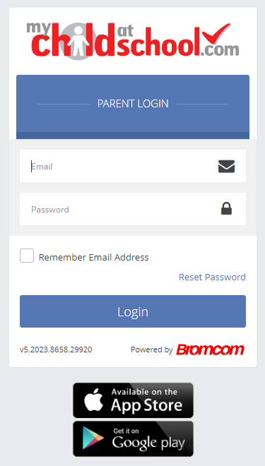
MCAS / The Portal
MCAS is available in an internet browser (https://www.mychildatschool.com/MCAS/MCSParentLogin?schoolid=12728) or via the MCAS app in the App Store or Google Play.
To log in, you just need your email address and a password. The first time you access MCAS click on Reset Password to set a password. Further details and links to the login page can be found in the Newsletter.
If you have any problems accessing MCAS, please email churchill@churchill-academy.org
Notes:
RM

Slide 51
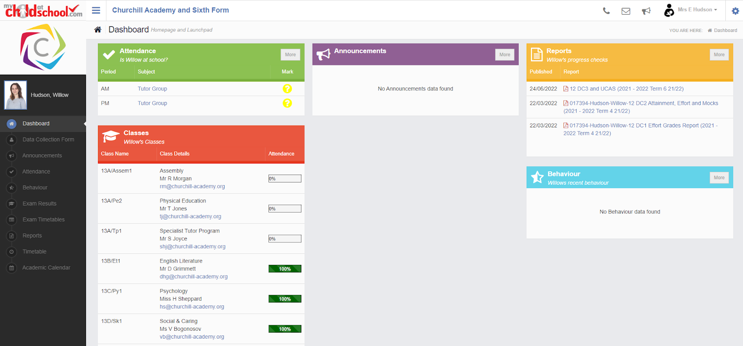
For MCAS queries please email mcas@churchill-academy.org
Notes:
RM

Slide 52
Health
If your child requires a Health Care Plan please contact our School Nurse,
Biz Hembrow.
New health issues?
Historic HCPs that are no longer needed?
Please email churchill@churchill-academy.org
Notes:
RM

Slide 53
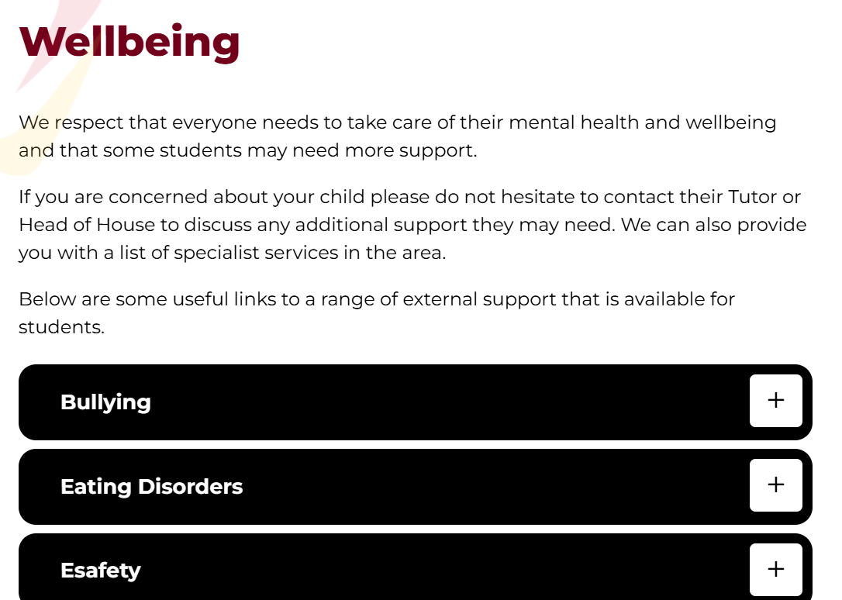
Mental Health
Please visit our website for links to support available for students
https://www.churchill-academy.org/wellbeing
Sirona
MHST

Slide 54
Attendance Policy
Students cannot authorise their own absence.
Parents need to call the absence line 01934 854065
or email attend@churchill-academy.org.
The school day is reserved for Sixth Form lessons and study. It is not a time for part time work or other non-school related activities.

Slide 55
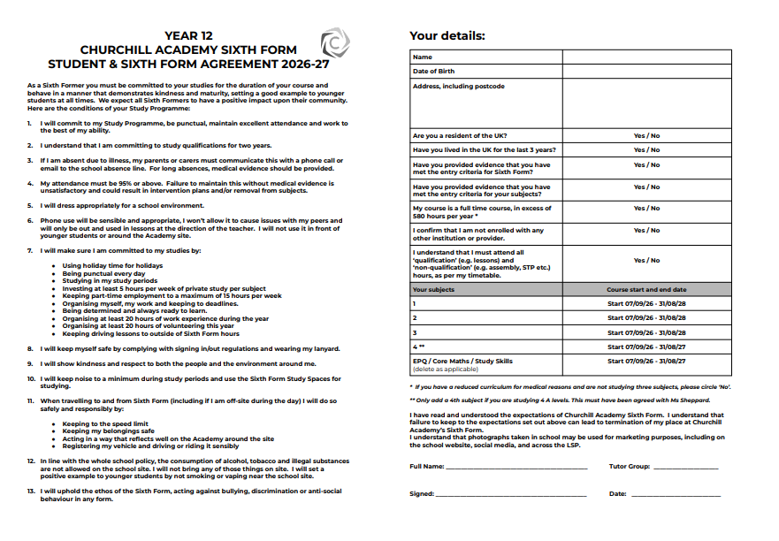
Notes:
JJB

Slide 56


Slide 57

The Sixth House

Slide 58
Systems: Rewards and sanctions
House Points:
One House Point: any positive behaviour in line with the Academy’s expectations and values - “I’ve done more than just avoid getting a behaviour point”
Two House Points: consistent, repeated or significant positive behaviour in line with the Academy’s expectations and values
Three House Points: a “WOW” reward for a special contribution to the Academy or positive behaviour which goes over and above expectations, or sets a role model example for others to follow
What happens if a negative behaviour
pattern develops?
Behaviour contracts and targets
Removal of ‘freedoms’
Parent/Carer meetings with Tutors, Head of Year, or Head of Sixth Form.
Removal from Sixth Form
Notes:
One House Point = above and beyond meeting the basic expectations. This could include modelling positive behaviour, setting a good example, or going above and beyond the basic expectations.

Slide 59
What happens if academic difficulties occur?
The right balance of challenge and support.
Structured and strategic help.
Involvement of subject teachers and, depending on issues, tutor → Year Head → Deputy / Head of Sixth Form.
Parental contact.
Proactive.

Slide 60
Sanctions
Academic Concern - e.g. underperforming in a test
Behaviour Point - e.g. inappropriate dress code or not having the right equipment
Breach of Code Sanction - e.g. swearing, defiance, truancy, vandalism, racism.

Slide 61

PSHE and The ‘Sixth House’
Cognitive Behaviour
Social Behaviour
Emotional Behaviour

Slide 62

Post-16 Bursary
Notes:
RM

Slide 63
Careers Advice and Guidance
Information, advice & guidance careers meetings are available by request via a student's tutor.
Notes:
RM

Slide 64
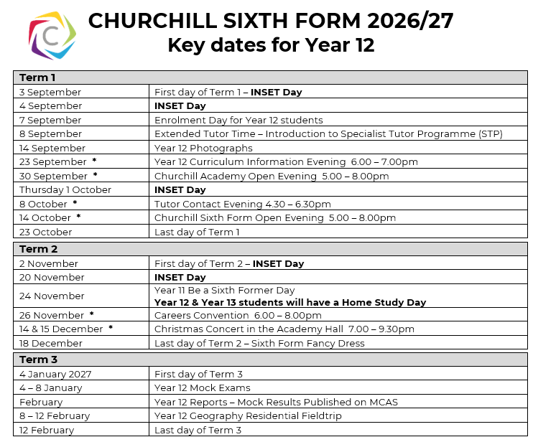

Slide 65
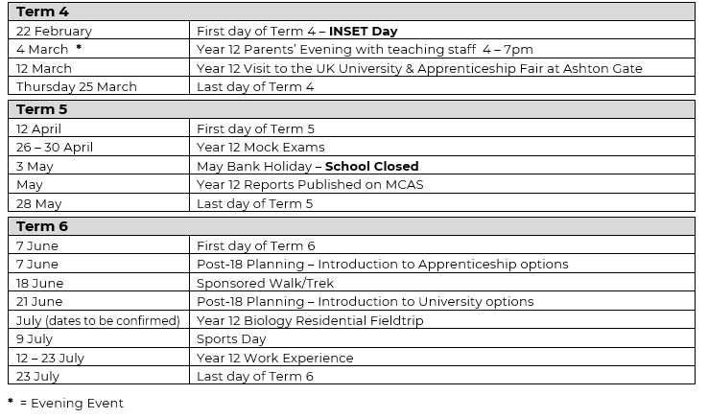

Slide 66


Unifrog is an online platform that helps students explore career pathways, compare universities and apprenticeships, and manage their applications all in one place.
Notes:
RM

Slide 67

What is Unifrog?
Unifrog believe that destinations - where students end up after school - is even more important than their academic performance. They partner with schools to support students to progress into the best opportunity for them.
Unifrog do this by providing a one-stop-shop where students can explore their interests, then find and successfully apply for their best next-step after school.
Notes:
RM

Slide 68
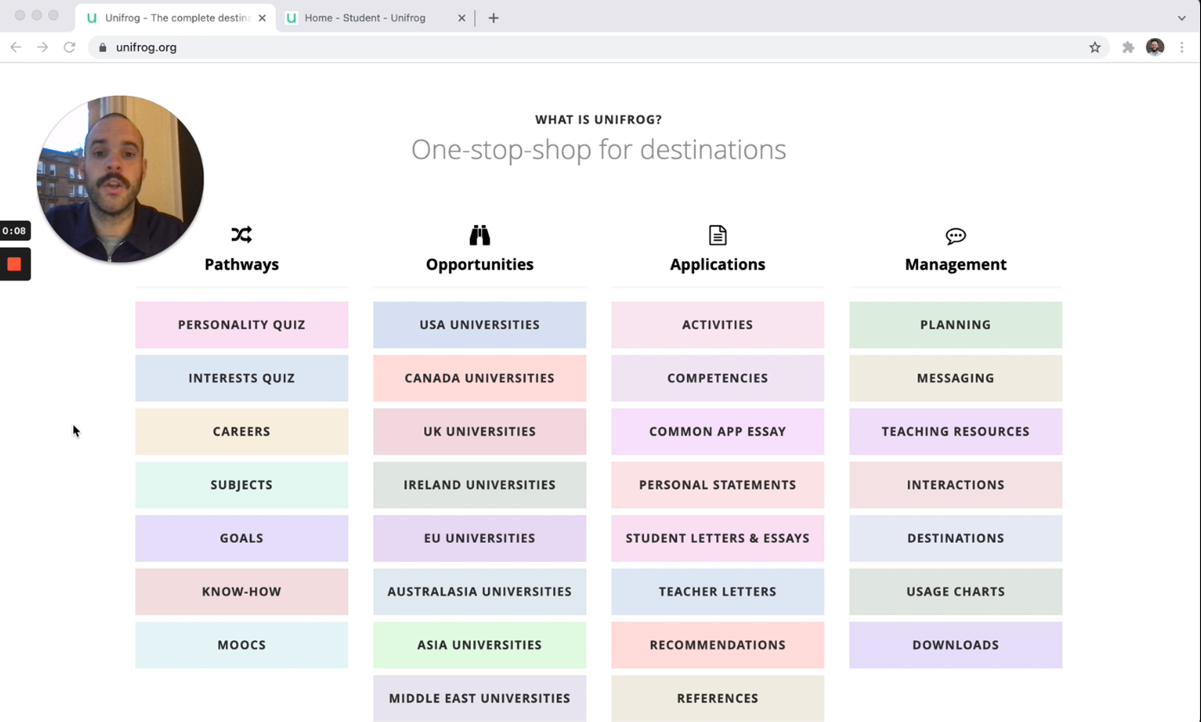
Unifrog introduction for parents
Click to watch!
Notes:
Notes:
Video (with audio) - 5 minutes
Holding Ctrl and clicking the image will take you to the Loom website to play the video.
Direct link: https://www.loom.com/share/66fb402cc8374193b385f6dfd765c879

Slide 69
The Unifrog tools
Exploring pathways
Recording what you’ve done
Searching for opportunities
Drafting application materials
Making applications
Careers library
Activities
UK universities
UK Personal Statement
Post 18 Intentions
Subjects library
Competencies
US universities
Classes
Locker
Know-how library
Interactions
European universities
Subject References
Applications list
MOOC
Oxbridge
CV / Resumé
Personality profile
Canadian universities
Writing tool
Interests profile
Asian universities
Common App Essay
Read, Watch, Listen
Australasian universities
US recommenders
Webinars
ME and African universities
Notes for Reference writers
Irish universities
Special Opportunities
Events
Notes:
RM

Slide 70
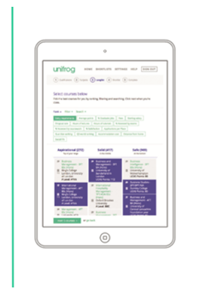
Exploring pathways
Careers library
The tools in the Exploring pathways section allow your child to research the types of exciting options available to them after school.
Subjects library
Know-how library
MOOC
Personality profile
Interests profile
Read, Watch, Listen
Webinars
Notes:
RM

Slide 71
Searching for opportunities
UK universities
US universities
The tools in the Searching for opportunities section allow you to compare universities, degree options and special opportunities around the world.
European universities
Oxbridge
Canadian universities
Asian universities
Australasian universities
ME and African universities
Irish universities
Special Opportunities
Events
Notes:
RM

Slide 72
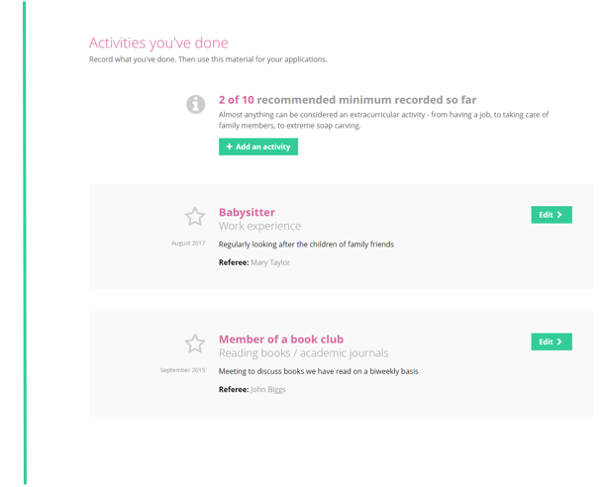
Recording what you have done
Use the tools in this section to start Recording what you have done!
Use guidance and examples to prepare students for making applications.
Activities
Competencies
Interactions
Notes:
RM

Slide 73
Other cool stuff
The Unifrog platform contains so much more than what we can show you today - there are many other tools available!
So why not see for yourself? Sign up as a student and access the tools in exactly the same way that the students do.
You never know, there might be a new career just around the corner!
Notes:
RM

Slide 74
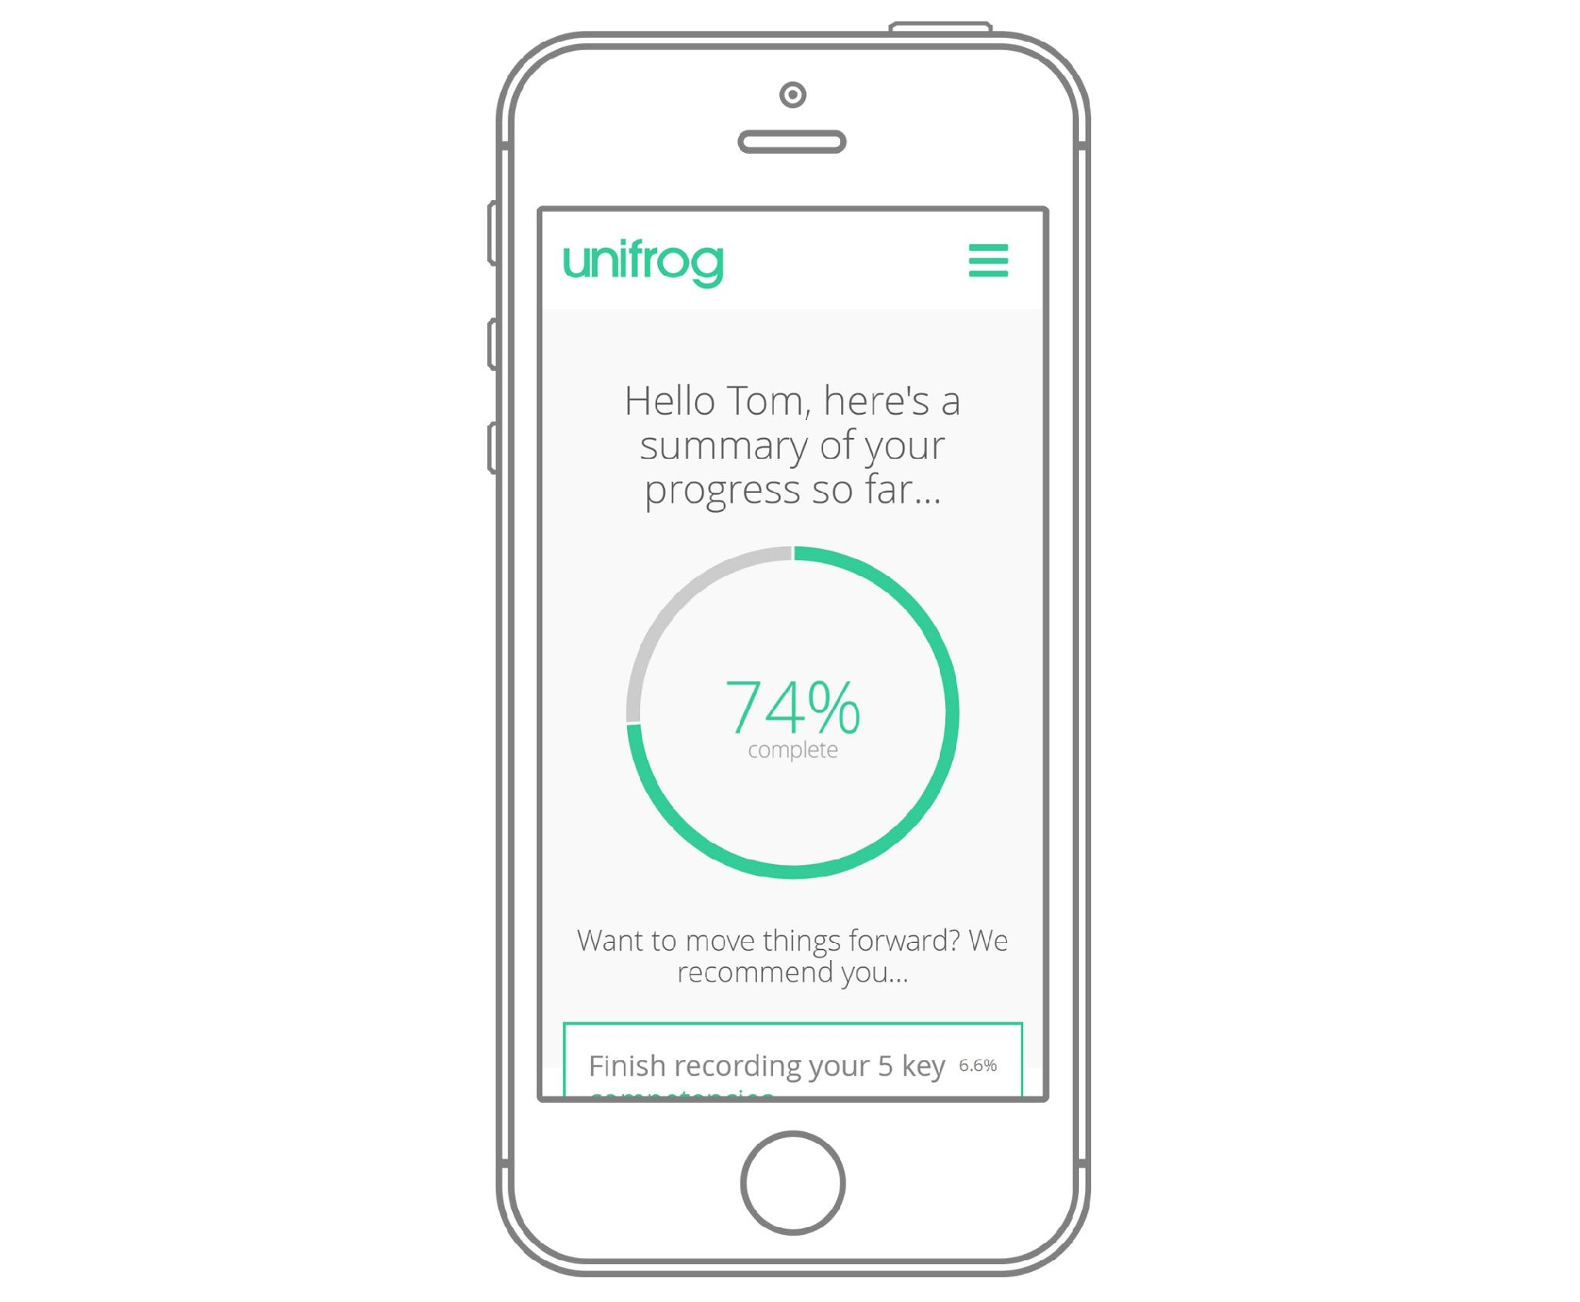
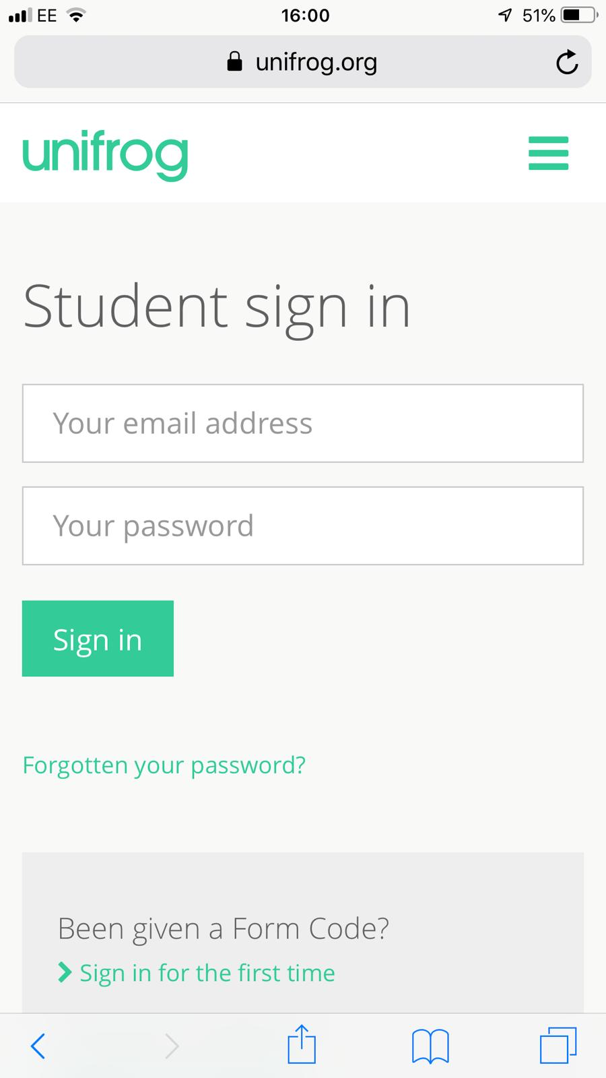
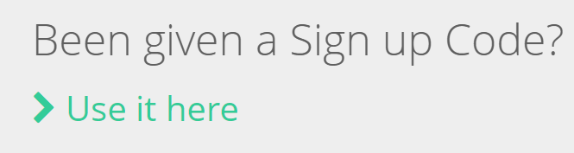
Parents & guardians, get signed up for a free trial!
Go to https://www.unifrog.org/sign-in and click ‘Been given a Sign up Code?’
You’ll be asked for some details and a sign up code. This is what you need:
<<Insert Parent Sign up Code here>>
Code: CASFParents
After signing up, log into Unifrog using your email address and password via the student sign-in page!
Notes:
Notes: Let help@unifrog know if you’d like to set up a parent code! Parent codes are only valid for 90 days so if your code is not visible on Unifrog at the link below, let us know on help@unifrog.org and we can create a new one for you:
https://www.unifrog.org/teacher/overview/sign-up-codes

Slide 75
Thanks for coming!
Any further queries, please contact:
sixthform@churchill-academy.org
or contact your young person’s Tutor.
Don’t forget Tutor Contact Evening on 8/10/26.
More information to be sent out shortly.

