Slide 1

Welcome to the Year 13
Information, HE and Apprenticeships evening

Slide 2
Ms Sheppard – Head of Sixth Form
Mr Smith – Deputy Head of Sixth Form
Mr Bevan – Head of Year 12
Mrs Wilson - Head of Year 13
Mrs Thompson – Sixth Form Lead Administrator
Notes:
RM

Slide 3
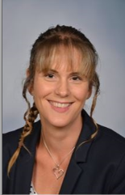




Sixth Form Leadership
Notes:
RM

Slide 4
The structure for tonight
Key information about the start of term
Nicky Rogers, UWE - University pathways: finding the right course and University, applications understanding student finance
Donna Kenny - Understanding Apprenticeships
Churchill deadlines and processes
Other information about the rest of the year!

Slide 5

Key information
Behaviour & Attendance
Post 16 Bursary
Predicted Grades
Notes:
HS

Slide 6
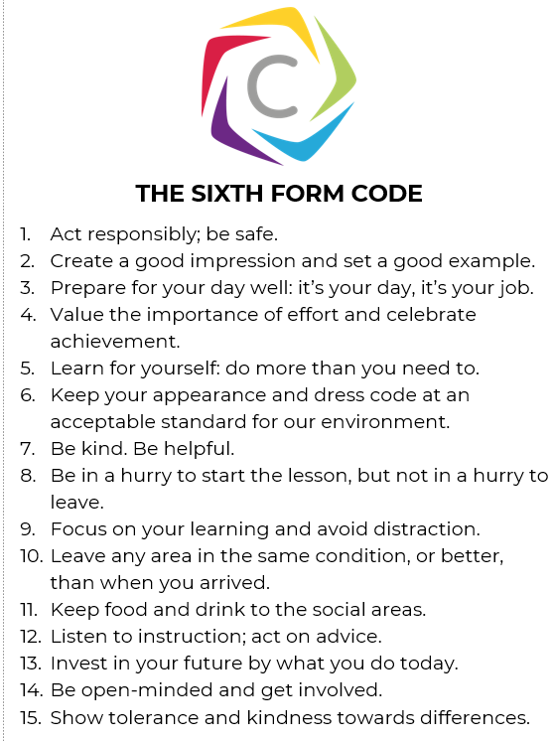
Notes:
JJB

Slide 7
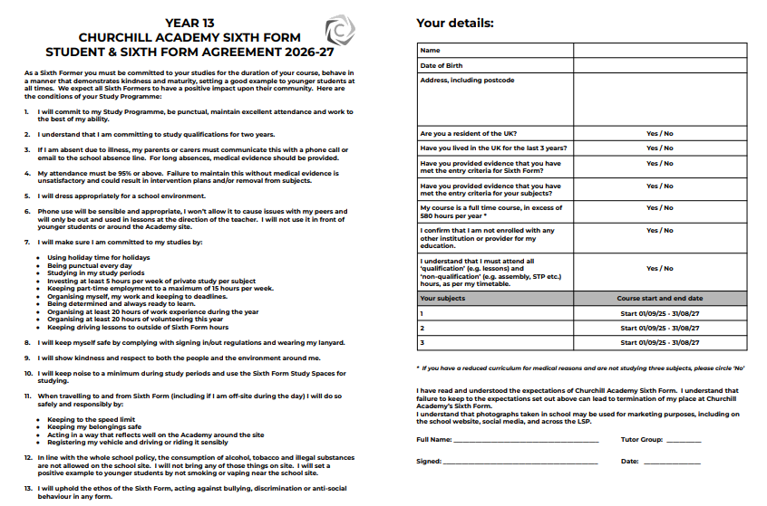

Slide 8

Notes:
JJB

Slide 9
Times of the Day
8.35-9.00am Tutor Time
9am Period 1
10am Period 2
11am Break time
11.20am Period 3
12.20pm Period 4
1.20pm Lunchtime
2.05pm Period 5
3.05 pm End of the day
Please note, the school day is reserved for Sixth Form activities - part time work, etc. is not permitted during this time.
Notes:
JJB

Slide 10
Attendance
Attendance is an essential prerequisite for good attainment.
95% attendance = 2 weeks missed
90% attendance = 1 month missed
85% attendance = 1 term missed
*This is especially important in subjects with lots of coursework - in order to account for the rise in the use of AI, teachers must be able to regularly assess knowledge in the classroom to be certain work is authentic!

Slide 11
The Sixth Form Behaviour
Policy and Curriculum

Slide 12

The Sixth House
Cognitive Behaviour

Slide 13
The Sixth House
Social Behaviour

Slide 14
The Sixth House
Emotional Behaviour

Slide 15
Systems: Rewards
House Points:
One House Point: any positive behaviour in line with the Academy’s expectations and values - “I’ve done more than just avoid getting a behaviour point”
Two House Points: consistent, repeated or significant positive behaviour in line with the Academy’s expectations and values
Three House Points: a “WOW” reward for a special contribution to the Academy or positive behaviour which goes over and above expectations, or sets a role model example for others to follow
Notes:
One House Point = above and beyond meeting the basic expectations. This could include modelling positive behaviour, setting a good example, or going above and beyond the basic expectations.

Slide 16

House Points: The Sixth House
House Points ‘fit’ with Sixth Form as we have re-identified ourselves as ‘The Sixth House’. This theme helps shape our behaviour curriculum along three themes.

Slide 17
Sanctions
Academic Concern - e.g. underperforming in a test
Behaviour Point - e.g. inappropriate dress code, lack of focus or not having the right equipment
Breach of Code Sanction - e.g. repeated BP, swearing, defiance, truancy, vandalism, racism. These hold different tariffs, some are more serious than others.

Slide 18
What happens if a negative behaviour
pattern develops?
Behaviour contracts and targets
Removal of ‘freedoms’
Parent/Carer meetings with Tutors/Head of Year/ Head of Sixth Form.
Removal from Sixth Form

Slide 19
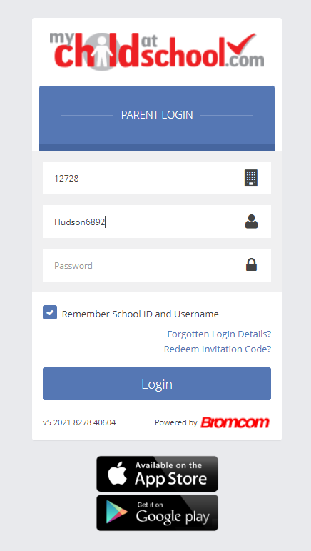
MCAS / The Portal
MCAS is available
in a internet browser (https://www.mychildatschool.com/MCAS/MCSParentLogin) or via the MCAS app in the App Store or Google Play.
To log in, you need the school ID (12728), your unique username and a password.
If you don’t have this, please email mcas@churchill-academy.org

Slide 20
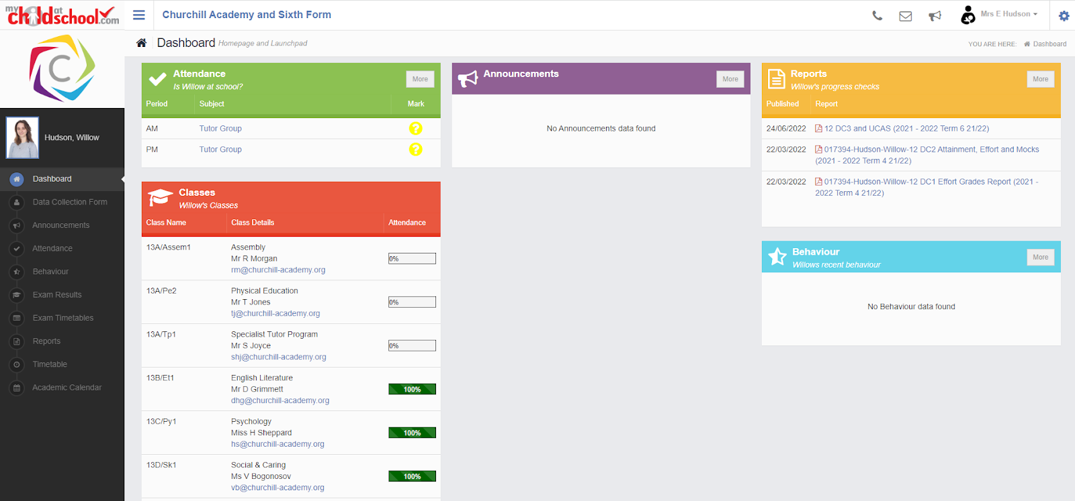
For MCAS queries please email mcas@churchill-academy.org

Slide 21
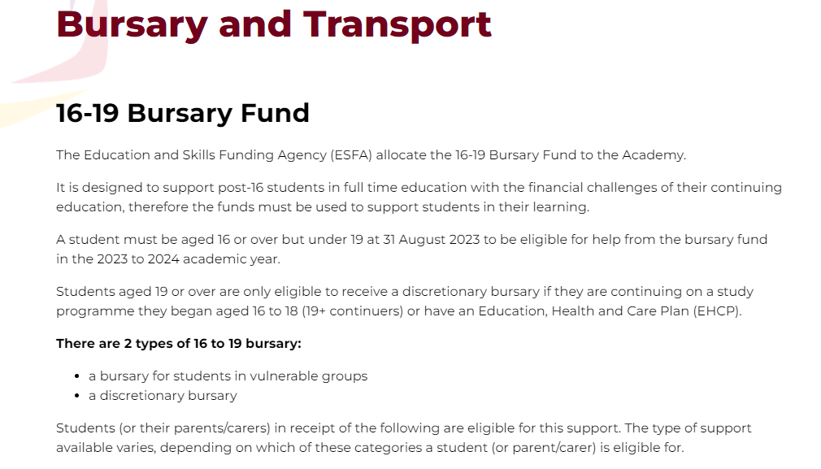
Post-16 Bursary
Please check if you are eligible by using the information on the website. The form can be completed online or a Word version can be completed.
If unsure, please contact 6thform@churchill-academy.org
Notes:
RM

Slide 22
UCAS vs Target Grades
- what is the difference?
UCAS | Predicted Grades
Set by teachers based upon their experience of the student’s performance in Year 12. Fixed at the end of September, Year 13. | Set by a national organisation
Based on knowledge of the student, effort/ATL, current attainment, homework and classwork class tests, assessments etc. | Set using an algorithm that takes into account performance of other similar students in other similar schools (similar = prior attainment, birth month and gender)
Seen by HE providers and used to make suitable offers | A minimum grade that students should be aiming for - these do not define students ability, many students exceed these grades.

Slide 23
2. Apprenticeships
Donna Kenny
Notes:
HS

Slide 24

Understanding apprenticeships
Notes:
Hello / good morning / afternoon
My name is ‘insert name’ and I’m here today on behalf of the Department for Education to talk to you about apprenticeships.
Apprenticeships are one of the many fantastic options available to you when you leave school/college/sixth form and are becoming increasingly popular with students who are looking at their next steps after school/college and are eager to jump straight into the world of work and get earning and learning.
It’s really important to keep your options open about your future. There are lots of new and exciting programmes, courses, training options and routes to help you into the career that you would like, or to explore future careers you may not know existed, all in a learning style and environment that suits you. It’s important to consider lots of different options so that if your plans change, you still have lots of exciting opportunities open to you.
So even if you already have a Plan A and Plan B, I would encourage you to listen carefully for the next 15-30 minutes or so and to ask lots of questions so that I can help you to explore how amazing apprenticeships are and whether they might be the right option for you.

Slide 25

What are apprenticeships?
Paid off the job training
Intermediate - degree
Typically, 8 months -6 years
Employed
Paid a salary
Real responsibilities
Not the easy option
Contract
700+ standards
Notes:
So what is an apprenticeship?
An apprenticeship is a real job, with a real employer, where the apprentice will work full-time whilst also studying towards a qualification.
So you could be an apprentice working for Sky as a journalist, for example, whilst also studying and gaining a qualification in journalism.
PAID A SALARY
As it’s a real job, you will earn a wage – and it can be a really good salary too! The salary of an apprentice can vary from employer to employer. Legally, an employer must pay an apprentice the National Minimum Wage for apprentices, which is currently £6.40 per hour. This is lower than the normal National Minimum Wage, but it recognises that some people will be going into their first job with little or no experience.
The good news is that lots of employers pay a lot more than the National Minimum Wage for apprentices, with some local employers offering starting salaries of £xx,xxx and other national employers even offering starting salaries over £15,000-£20,000.
I have sourced some local vacancy information, which I will show you in a little while, so you can see some real examples of local and national apprenticeships available and what types of salaries are being offered.
It’s important to remember that if you see an apprenticeship you’re interested in, don’t be put off by the pay if you consider it to be low: there’s room for progression and working your way to the top of an organisation.
CONTRACT
You will also get a contract of employment, holiday pay, annual leave etc. – exactly the same as any other member of staff.
STUDY AND WORK
The apprentice will spend the majority of their time ‘on-the-job’ (doing their role), and a minimum of at least 6 hours per week ‘off-the-job’, which means studying or working towards their qualification.
This study element (off-the-job) will take place with a training provider, who will help them to achieve the qualifications and make sure they complete their apprenticeship.
Training providers could be colleges, universities or independent training provider organisations, who deliver the training/teaching element of the course.
The employer will also support the apprentice, helping an apprentice to gain qualifications and valuable new skills and experience. As well as their time, employers also pay the fees of the apprentice’s training, showing their investment in the apprentice’s development.
TYPICALLY 1 – 6 YEARS
An apprenticeship typically takes 1 to 4 years to complete (sometimes up to 6 for some roles like a solicitor). As a minimum, all apprenticeships must last for at least 12 months.
The total duration will depend on the delivery model that the employer selects (how the mixture of training and working is delivered), the level (which I will explain later on) and the subject they are studying.
700+ STANDARDS and INTERMEDIATE – DEGREE LEVEL
There are more than 600 different apprenticeship standards covering many different levels of apprenticeships, from Level 2 (which is the equivalent of 5 GCSEs), all the way up to Level 7, which is the equivalent to masters level. So you can actually work your way towards gaining a degree or masters through an apprenticeship.
We will discuss this more shortly.
REAL JOB = RESPONSIBILITIES and NOT THE EASY OPTION
As I said before, it’s a real job and so it’s important to remember that apprenticeships aren’t the ‘easy option’.
Holding down a full-time job and studying takes a certain skill and commitment, and it won’t be right for everyone.

Slide 26
Levels of apprenticeships
Intermediate
Advanced
Higher
Degree
Equivalent to:
5 GCSE passes at grade 9-4 (A*-C)
Equivalent to:
2 A levels /
International Baccalaureate
Equivalent to:
Foundation degree and above
Equivalent to:
Bachelors or
master's degree
Level 2
Level 3
Levels 4-7
Levels 6 & 7
Notes:
Each apprenticeship has a level which will fall into one of the four categories above: Intermediate apprenticeships, Advanced apprenticeships, Higher apprenticeships and Degree apprenticeships.
The equivalent to part on the slide helps to explain what level the qualification at the end of the apprenticeship will be, in comparison to more familiar qualifications, like GCSEs and A Levels.
So you can see that if you do a level 3 (advanced) apprenticeship, for example, once you have qualified, you’ll have gained a qualification that is equivalent to 2 A Levels, a level 3 diploma or other equivalents, like IBs or BTECs.
The level of apprenticeship you start at will depend on the kind of job that you are applying for.
It’s really important not to be held back by only looking for a particular level e.g. degree apprenticeships. Apprenticeships work a bit differently to school which can be confusing, as lots of students think that they should progress onto the next level, so if you leave after GCSEs you should do a Level 3 and if you finish after A Levels you should go for a degree apprenticeship, but this isn’t always the case.
Presenter note: Click for animation.
Depending on the sector and apprenticeship, it may be that you need to start at advanced or higher level and work your way up, or that brilliant apprenticeships are only offered at certain levels – for example, an estate agent apprenticeship is offered at Level 2 because that is all the industry requires.
Equally, you may be entering a completely new sector or industry that you haven’t studied or worked in before, and so may need to do a Level 2 or 3 to enter the world of work and start at the correct level of understanding. Doing a job is completely different to getting a GCSE or A Level and that’s why it can be a bit confusing.
It is very important to keep an open mind so that you can explore all of the opportunities available and have multiple options available when applying.

Slide 27
Range of apprenticeships
Cyber
Security
Paralegal
Quantity Surveyor
Dietician
Aerospace Engineer
Paramedic
Visual Effects Artist
Architect
Zookeeper
Ecologist
Business Administrator
Chef
70%
The range of occupations is huge According to Government statistics, nearly 70% of occupations can now be entered via an apprenticeship
Notes:
Presenter note: Please add in some local opportunities to the slide above (a mixture of traditional and non-traditional job titles) to also bring the range of the local offer and facilitate discussions below.
We’re now going to take a look at the different job roles available through an apprenticeship and when we talk about apprenticeships, people often start to think of Plumbing, Electrical and some of the other construction trades. There are many brilliant apprenticeships in these areas, but there are also hundreds of new apprenticeships in exciting areas that you might not know exist.
Presenter note: Suggested interactivity: Ask the audience ‘does anyone know of any apprenticeships that they might expect to see on this list?’
Once completed, click on for the image.
The range of apprenticeship job roles out there is amazing.
This slide gives you an idea of the huge range of apprenticeships available and this is just a taster – there are now over 700+ different apprenticeship standards available, resulting in over 1,500+ different job roles.
You could start an apprenticeship in hundreds of occupational areas. Some will amaze you!
Presenter note: Suggested interactivity: Depending on the time available…
Activity idea: Pick out a few of the job roles to discuss – will depend on the audience.
Activity idea: Can anyone spot an apprenticeship on the screen that has surprised them?
Activity idea: Does anyone know someone who is doing an interesting apprenticeship?

Slide 28
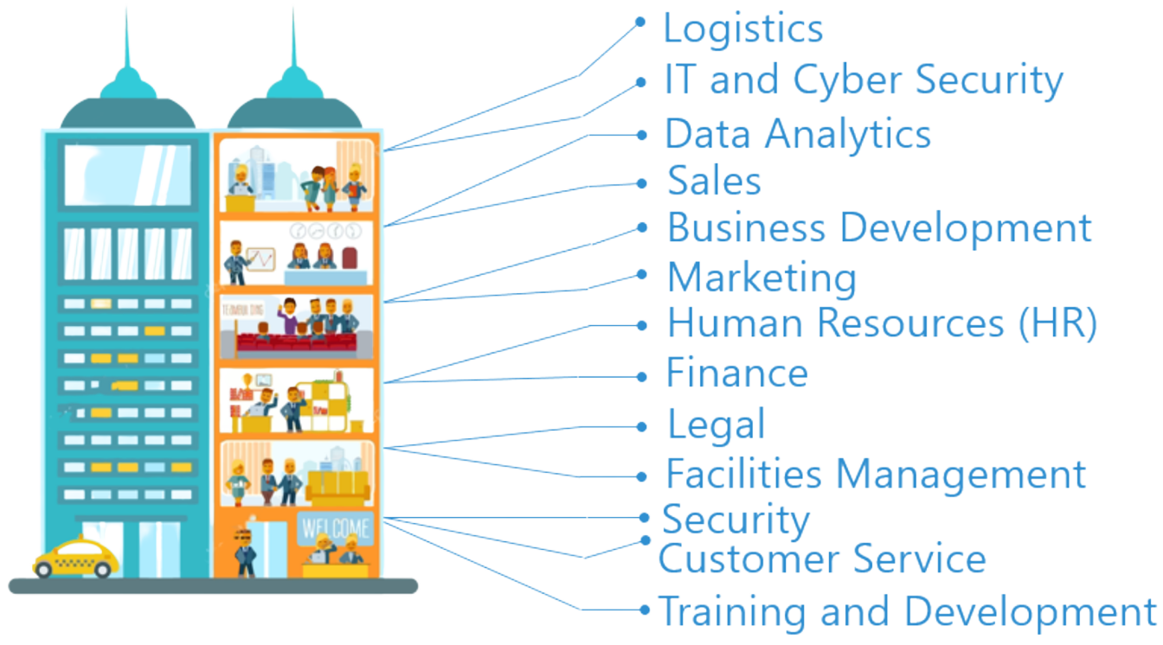
Look inside the company
Logistics
IT and Cyber Security
Data Analytics
Sales
Business Development
Marketing
Human Resources (HR)
Finance
Legal
Facilities Management
Security
Customer Service
Training and Development
Notes:
You also need to think about the different roles that a company might have.
For example, if you want to work in finance – you shouldn’t just look at the big finance and accountancy companies. Lots of other companies will have their own in-house finance departments where you will still have access to a huge range of experiences and opportunities.
It can be a good idea to take some time to look at the different departments that a company has and see if they offer an apprenticeship in that area.
For example, you could work as a solicitor for Coca-Cola, a website designer for Vauxhall, as a Cyber Security apprentice for the Government.
There are thousands of different opportunities!
Presenter note: Please update the example if you feel that mentioning Vauxhall or Coca-Cola is not representative of your area.

Slide 29

Are there vacancies?
Radius
Number of vacancies
5 miles
6
10 miles
25
15 miles
78
20 miles
109
England
3,710
Notes:
Presenter note: We would expect this slide to be updated by the delivery partner to reflect local opportunities by searching through Find an Apprenticeship.
So as I said before, I had a look on the Find an apprenticeship website before coming along today so that I could see how many vacancies are out there at the moment.
If you notice, within 5 miles of this school/college today, there are xx vacancies.
You can see how this number grows the more you increase the distance.
You will need to think about how far you are prepared to travel for work each day.
If you want to think about working in the (insert name of an appropriate town/city), then you could be looking for vacancies there.
The one rule is that you will need to be able to get there, on time, every day.
Remember, it is important not to restrict your searches for vacancies to just look at large companies as many small employers offer some excellent vacancies with great packages and career progression opportunities.
It is also important to do some wider research and look in lots of places for apprenticeships, which we will discuss more on shortly.

Slide 30

Apprenticeships in the local area
Job opportunity | Level | Annual salary
Apprentice Dental Nurse | Level 3 | £17,472
Software Developer Apprentice | Level 4 | £22,000
Plastering Apprentice | Level 2 | £16,640
Solicitor Apprentice | Level 7 | £31,657
Notes:
Presenter note: Please update this slide with relevant examples for your audience.
Search through Find an apprenticeship using the establishment postcode and find some interesting jobs.
Try to find a selection of closing dates so that you can reinforce the need to be using Find an apprenticeship regularly.
Try to find a range of salaries so that you can show that there are employers who are prepared to pay more – often highlighting salaries can be high at all levels, not just degree apprenticeships.
Try to find a job title that might sound a bit confusing and then explain what that role really is – make it sound exciting and explain that they should not be put off by the titles of some jobs, it’s important they read the job advert attached to it.
Think about STEM vacancies. Can these be showcased more?
This slide shows a range of vacancies that I could find.
You will notice that they all have different closing dates – this is one big difference to applying for university.
If you do see a closing date, it’s important that you don’t wait until the very end to submit your application. We are finding from talking to employers, that if they receive a huge number of applications, they may decide to close the application window early.
You will also notice the range of different salaries too – this is because employers can decide what to pay (as long as it meets the national minimum wage for apprentices of £6.40)
Presenter note: It might be useful to have the find an apprenticeship website open to show them current examples and what the site looks like. This is also relevant for the next slide.

Slide 31
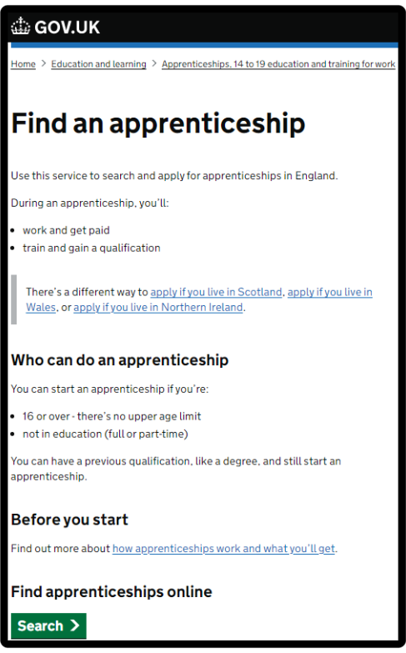
How do you find apprenticeships?
WHAT IS FAA?
Showcasing live apprenticeship jobs
20,000+ vacancies
over the year
Free to use
Secure site
Apply quickly
This is just one way …
Notes:
Where did I find these vacancies? So one of the first places to look is Find an apprenticeship, the government portal for apprenticeship jobs.
It’s really important that you register. Search the internet for ‘Find an apprenticeship’ and it will come up as the first link.
The search page is on gov.uk, an official government site.
Have a look at the different jobs that are being advertised. Remember, this is a live jobs site so it may be that you need to try and few different searches or to broaden how far you are looking to find jobs that you are interested in. It also means different vacancies will come up at different times so do not be disheartened if you don’t find something straight away, you may want to look again at another time or on different jobs/employer websites.
Start applying for jobs that interest you. You need to remember that typically, some of the bigger companies will advertise quite early in the year (e.g. September/October) for apprentices to start the following September so please don’t leave it until the last minute or you might be disappointed to have missed a great opportunity.
Others may come up later in the year closer to the time you are looking to start your apprenticeship, so use the website to help you with the next step.
Set up your alerts. A great feature of this system is that you can get it to do all the hard work for you. You can manage your alert settings so that you receive emails when jobs come up that you might be interested in.
Employers are always telling us that the applicants that really stand out to them are those that have made a bit of extra effort. You could consider contacting the company and asking them if they have any virtual open days coming up, or work experience or other opportunities to engage with them. That will look really impressive on your application and can give you an advantage over other applicants.
Find an apprenticeship has some new features so we will be working with you to create an account / can share information about resources that will help you to set up an account.

Slide 32


Where else to look
UCAS website
Recruitment websites
Company websites
Careers websites
College and Universities
Independent training providers
Social media
Friends and family
Notes:
Whilst Find an apprenticeship is a great place to start looking for apprenticeships, it is not the only place.
If you have a particular employer in mind, visit their website and see if you can sign up for recruitment alerts or if they send out a newsletter.
Make sure you follow their careers pages on social media using Facebook, Twitter and Instagram too as they will probably use this as a way to promote their vacancies. If you have a LinkedIn profile, it is worth following organisations on there as we have heard from many apprentices more recently that they have found vacancies from employers or training providers on LinkedIn. If you don’t yet have a profile, it may be worth exploring or asking for support in creating one from your school careers adviser or a parent/carer.
We have spoken to lots of apprentices and quite often, they will say that they actually heard about their job through a family member or friend. So make sure you tell everyone you can think of that you’re looking for an apprenticeship and you never know what might come through!
There are lots of other job search sites out there where you can flick through online profiles for some of the UK’s top apprentice employers.
Definitely spend some time looking into the different types of employers. There will be a real mix from your local council who might have a jobs page for young people, through to bigger recruitment sites too.
The Higher & Degree vacancy listing is also a really useful document that is shared in November and then an updated version is released again in February. This contains a list of hundreds of higher and degree apprenticeship vacancies that are open for application, and gives key information about the employer, the apprenticeship, the salary, location and where to apply. This will be shared on the Amazing Apprenticeships website and apprenticeships.gov.uk.

Slide 33

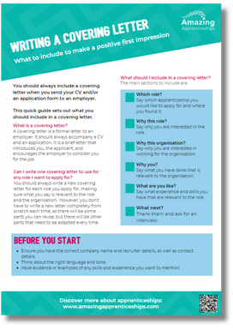
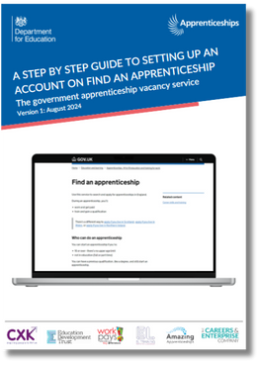




Useful websites & resources
Resources to support you in learning about apprenticeships
Application guides
Factsheets
Using Faa guide
www.amazingapprenticeships.com
Employer profiles
Apprentice advice
Notes:
There are an array of resources that can support you in finding out more about apprenticeships.
You can visit Amazing Apprenticeships’ website to find useful:
- Application guides
- Factsheets and guides providing hints and tips
- A guide on how to use Find an apprenticeship and set up your account properly
- A range of webinars with experts and employers talking about apprenticeships, what’s available, explaining the different levels and opportunities and giving
application advice and guidance
- Profiles of top apprenticeship employers exploring what they offer and how to apply, with guidance from their recruitment teams
- Advice from apprentices through films, case studies and other resources

Slide 34
Students had an introduction to apprenticeships
last academic year.
They had further support from former Churchill student Sophie Townsend and her Apprenticeship employer Amentum, as well as the opportunity to attend an Apprenticeship workshop with our Independent Careers Adviser, Ms McGonigal.
Students are emailed with opportunities regularly.
Apprenticeships are competitive - have a plan B.

Slide 35
3. University Pathways
Nicky Rogers, UWE
Notes:
HS

Slide 36

Information on how to apply through UCAS has been shared with students via Assemblies, through our Specialist Tutor Programme (STP) and
via email.
Further support sessions on writing personal statements and completing applications are planned for the coming weeks in STP.
Where to go for help:
Contact the Head of Year initially:
Mrs Wilson
Academy Website

Slide 37

UCAS parents guide
Available from the UCAS website
https://www.ucas.com/discover/advice-for-parents-guardians-and-carers/parent-guardian-and-carer-guide

Slide 38
4. Churchill deadlines and processes
 | Churchill | UCAS
Early Applicants - Oxbridge, Medicine, Veterinary, Dentistry | 30th September | 15th October
All other UCAS applications | 1st December | 13th January
Notes:
HS

Slide 39
5. Other information
STP & super-curricular
Communication/MCAS
Health and Mental Health
Mock exams
Key dates
Home Study
Work Experience
Unifrog
Notes:
HS

Slide 40
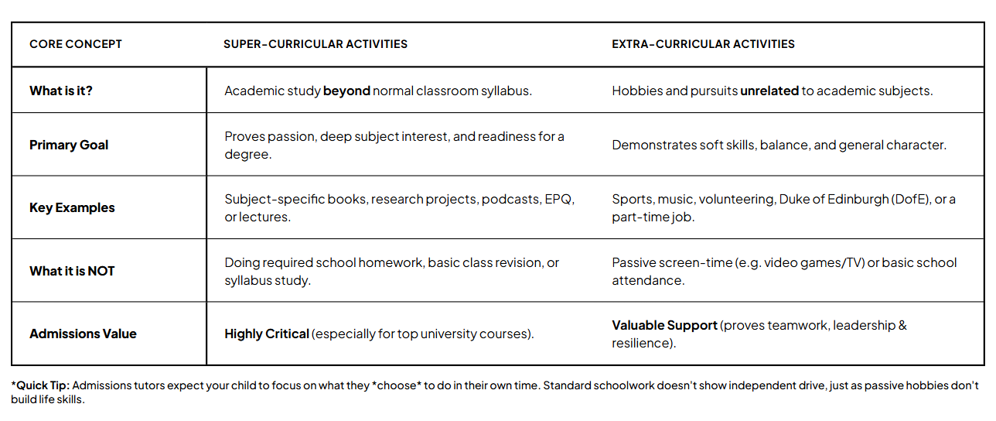
Super-curricular learning
Notes:
TH

Slide 41



Super-curricular learning
Watch films in the language you’re studying If you find it hard at first, you could watch with English subtitles to begin with. | Start a blog about your subject. | Watch Podcasts and videos https://podcasts.ox.ac.uk/ https://www.ted.com/
TED talks. A good place to start are ted talks recommended by students for students. https://www.weareteachers.com/ted-talks-students/ |  | Staircase 12 is hosted by Oxford University and has lots of ideas to help students extend their knowledge beyond the school syllabus. https://www.univ.ox.ac.uk/applying-to-univ/staircase12/
(Unifrog has a tool to help you find one) | Work experience and volunteering | Wider reading
Notes:
https://www.undergraduate.study.cam.ac.uk/files/publications/super-curricular_suggestions.pdf
https://www.ashmoleacademy.org/page/?title=Super%2DCurricular+Activities&pid=725
https://www.univ.ox.ac.uk/applying-to-univ/explore-your-subject/
https://www.ox.ac.uk/admissions/undergraduate/increasing-access/ug-digital-resources
https://academic.oup.com/pages/very-short-introductions

Slide 42
Super-curricular learning through STP
13DG | STEM
13GES | Business / IT / Law / Economics
13LB | STEM
13OWC | Humanities / Social Sciences
13SB | Creative / Performance
13VB | Humanities / Social Sciences

Slide 43
The Specialist Tutor Programme (STP) is every Thursday, Period 2.
Activities for the week are published every Monday.
Aims:
To provide specialist support, advice and guidance through a programme of activities that are tailored to the Personalised Curriculum.
Super-curricular learning
Aspirational encounters
Projects and activities that develop skills and competencies
Life-skills and personal development
Study skills and academic support
Notes:
RM

Slide 44
STP Activity Examples
Speaker: Wildlife Film Making | What is a mortgage? | Environmental Action Group | Drama School Audition Prep
Uni Lecturer: Political Communications | Speaker: Apprenticeships in Accountancy | How to create effective study skills | Cooking for the homeless
Guest speaker: BIMM | Basic Aramaic | Oxbridge and Russell Group Prep | Making Music for TV
Grill a Vicar! | Alumni talk: Natural Sciences | How to build a portfolio | Understanding Freud
Prosthetics and make-up for Film | Personal Statement writing | First Aid | Plant propagation
Biomedical Engineering Event | Falmouth Uni: preparing for creative interviews | Bicycle maintenance | How to manage stress and workload
Notes:
RM

Slide 45
STP Activity Examples
Cognitive Psychology and AI | Black History - Jennifer Eberhardt, understanding bias | Disaster planning: climate crisis | Political Party visits e.g. Green Party
Uni Lecturer: Political Communications | Planning your gap year | Civil Engineers CITYZEN competition | Book club
Positive masculinity | Mastering presentation skills | TaskMaster: problem solving skills | Prosthetics and make-up
Ethics of cloning | Alumni talk: Natural Sciences | Stage Production Skills | Wire Sculptures
Composing for film and TV | What is Post-Modernism? | Understanding Tax | Business and sustainability
Wealth Management | Robotics | Astrophysics | Calligraphy
Notes:
RM

Slide 46

Careers, Advice and Guidance
Information, advice & guidance careers meetings are available by request via a student's tutor or direct to the Academy Careers Adviser, Suzie McGonigal:
smg@churchill-academy.org
or
careers@churchill-academy.org

Slide 47
Health
If your child requires a Health Care Plan please contact School Nurse.
Please email churchill@churchill-academy.org

Slide 48
Signposting to support agencies
Mental Health Resources are available on our website and from the students’ HoY.
Sirona
What they do: They work alongside young people and families offering support and information around topics such as sexual health, emotional support and relationships, sleep, smoking/vaping and healthy eating and exercise. Appointments and drop in sessions work in the same way that NHS appointments work and students can expect the same level of confidentiality.
What they offer: A lunchtime drop in session with Saskia EVERY Wednesday
MHST
What they do: In school CBT support for students with low to moderate mood or anxiety.
What they offer: 121 CBT sessions once a week on a Monday or a tuesday.

Slide 49
Mock Exams
Mock Exams Round 1: 23rd - 27th November
Mock Exams Round 2: 1st - 5th March

Slide 50
Work Experience and Volunteering
Students can continue to take part in work experience or volunteering in Year 13.
They should complete at least two weeks of work experience and volunteering over the two years, many have done that already, but there is no limit.
They can do this during the school day e.g. Wednesday PM or in their own time.
Notes:
HS

Slide 51
Arranging off-site placements
We provide a free service to help organise off site placements safely. This applies to work experience or volunteering during the ‘school day’ hours.
Please use Unifrog’s PLACEMENTS tool to organise the placement and complete H&S checks.

Slide 52
Tutor Contact Evening
Thursday 8th October, 4.30-6:30pm
Meeting with your young person’s Tutor to discuss progress, mocks, and progression plans.
These are only short appointments, please do get in touch with Tutors before that if you have any queries or concerns.

Slide 53
Unifrog is our all inclusive careers and progression resource with information on everyone.
Every student has access to it and should have built a strong profile of activities and skills over the last couple of years. In particular, by logging Work Experience, STP activities and other opportunities they have taken.
From this, they can build their Personal Statement and CV.
Parents have a trial account to use to see what it is like, please do, it’s great! See the last slide for your login, available until December.

Slide 54


Introduction to Unifrog
for parents

Slide 55
Unifrog is an online platform that helps students explore career pathways, compare universities and apprenticeships, and manage their applications all in one place.
Notes:
RM

Slide 56

What is Unifrog?
Unifrog believe that destinations - where students end up after school - is even more important than their academic performance. They partner with schools to support students to progress into the best opportunity for them.
Unifrog do this by providing a one-stop-shop where students can explore their interests, then find and successfully apply for their best next-step after school.

Slide 57
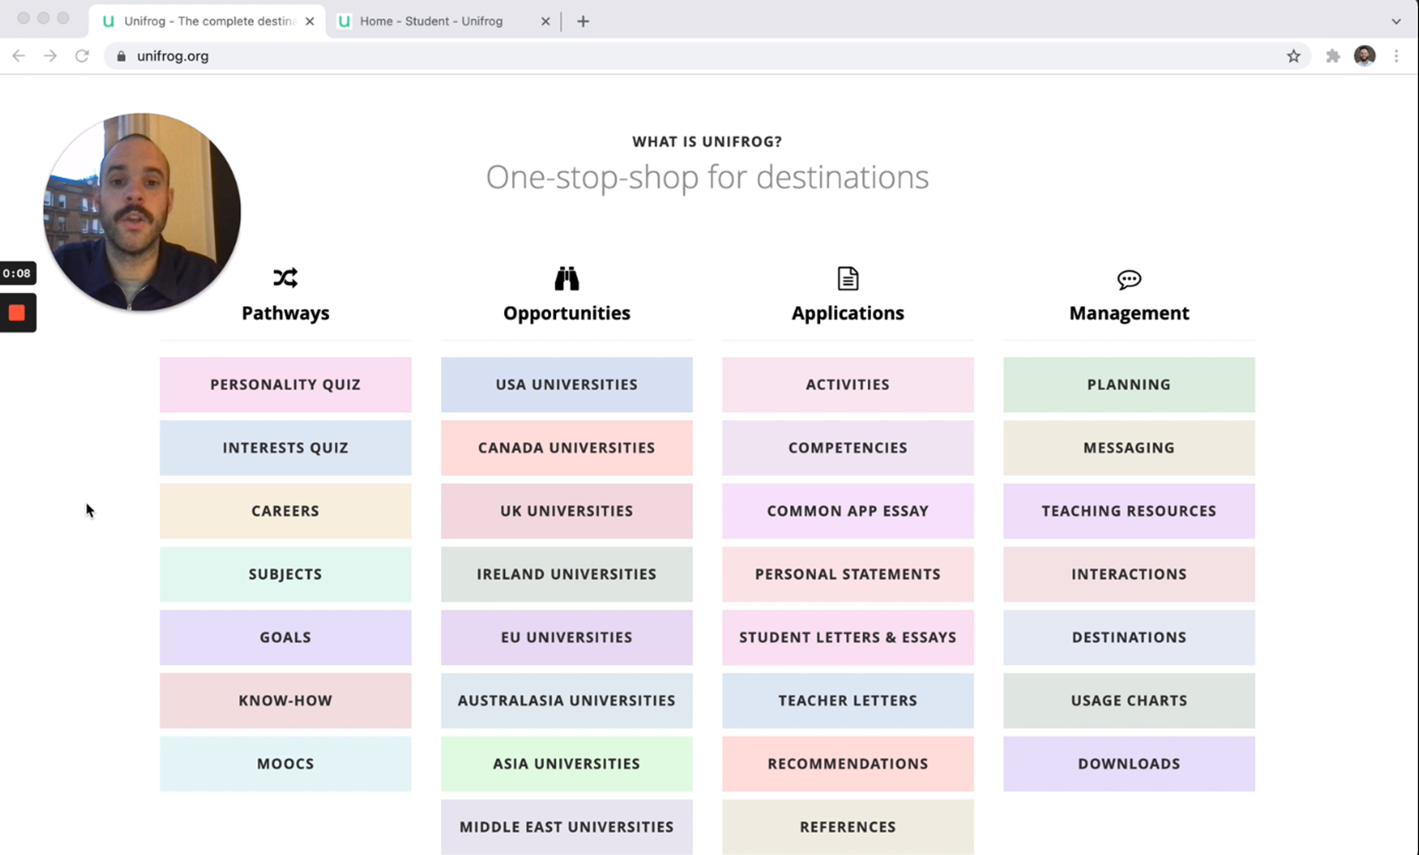
Unifrog introduction for parents
Click to watch!
Notes:
Notes:
Video (with audio) - 5 minutes
Holding Ctrl and clicking the image will take you to the Loom website to play the video.
Direct link: https://www.loom.com/share/66fb402cc8374193b385f6dfd765c879

Slide 58
The Unifrog tools
Exploring pathways
Recording what you’ve done
Searching for opportunities
Drafting application materials
Making applications
Careers library
Activities
UK universities
UK Personal Statement
Post 18 Intentions
Subjects library
Competencies
US universities
Classes
Locker
Know-how library
Interactions
European universities
Subject References
Applications list
MOOC
Oxbridge
CV / Resumé
Personality profile
Canadian universities
Writing tool
Interests profile
Asian universities
Common App Essay
Read, Watch, Listen
Australasian universities
US recommenders
Webinars
ME and African universities
Notes for Reference writers
Irish universities
Special Opportunities
Events

Slide 59
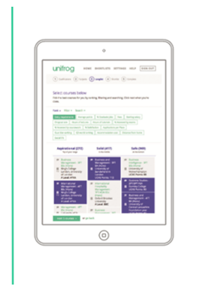
Exploring pathways
Careers library
The tools in the Exploring pathways section allow your child to research the types of exciting options available to them after school.
Subjects library
Know-how library
MOOC
Personality profile
Interests profile
Read, Watch, Listen
Webinars

Slide 60
Searching for opportunities
UK universities
US universities
The tools in the Searching for opportunities section allow you to compare universities, degree options and special opportunities around the world.
European universities
Oxbridge
Canadian universities
Asian universities
Australasian universities
ME and African universities
Irish universities
Special Opportunities
Events

Slide 61
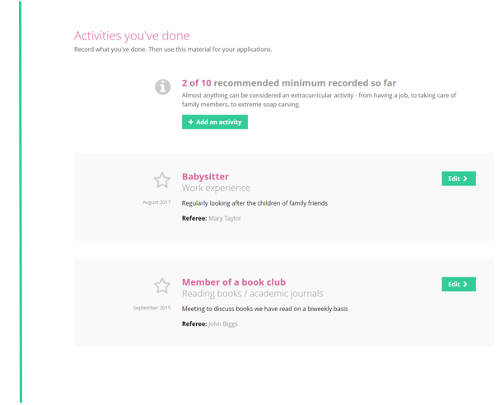
Recording what you have done
Use the tools in this section to start Recording what you have done!
Use guidance and examples to prepare students for making applications.
Activities
Competencies
Interactions

Slide 62
Other cool stuff
The Unifrog platform contains so much more than what we can show you today - there are many other tools available!
So why not see for yourself? Sign up as a student and access the tools in exactly the same way that the students do.
You never know, there might be a new career just around the corner!

Slide 63
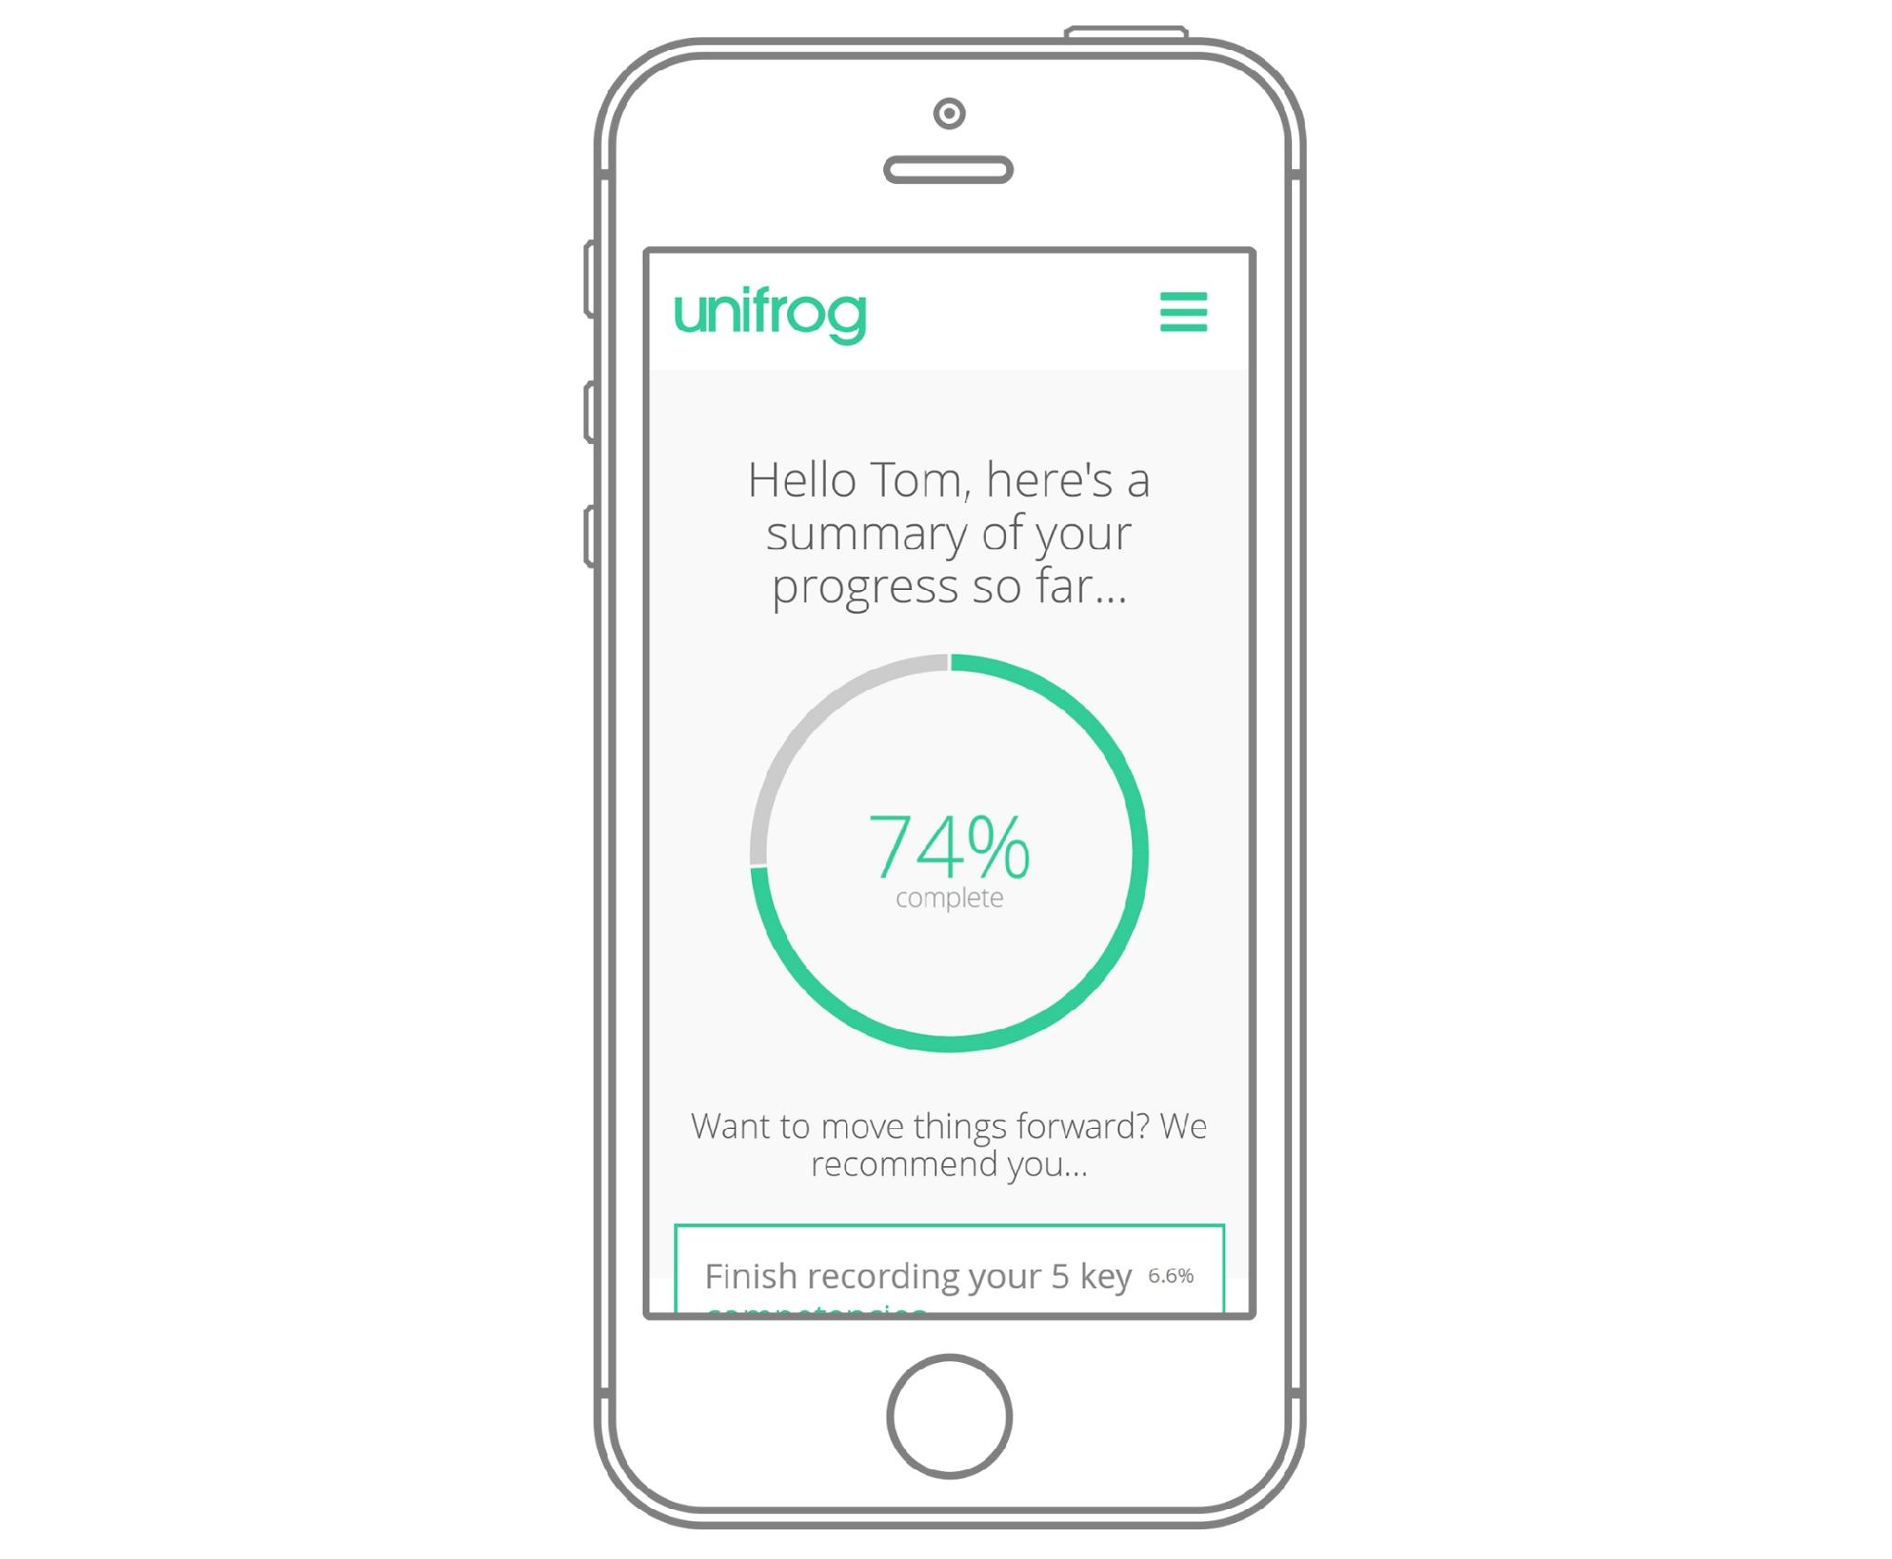
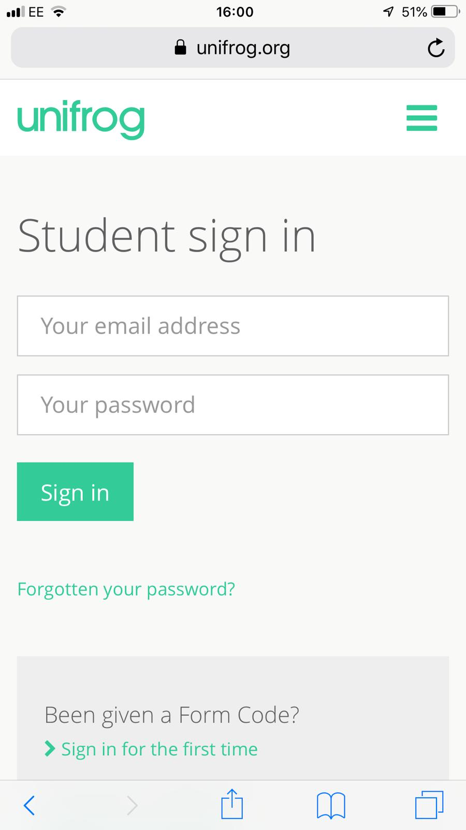
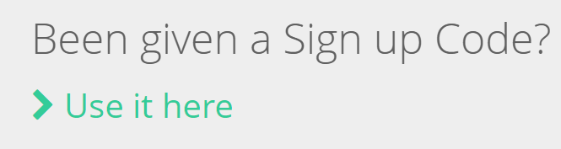
Parents & guardians, get signed up!
Go to https://www.unifrog.org/sign-in and click ‘Been given a Sign up Code?’
You’ll be asked for some details and a sign up code. This is what you need:
<<Insert Parent Sign up Code here>>
Code: CASFParents
After signing up, log into Unifrog using your email address and password via the student sign-in page!
Notes:
Notes: Let help@unifrog know if you’d like to set up a parent code! Parent codes are only valid for 90 days so if your code is not visible on Unifrog at the link below, let us know on help@unifrog.org and we can create a new one for you:
https://www.unifrog.org/teacher/overview/sign-up-codes

Slide 64
Thank you for coming!
If you have any further questions please stay to talk to us.
For any further issues, please contact your young person’s Tutor in the first instance.

Slide 65

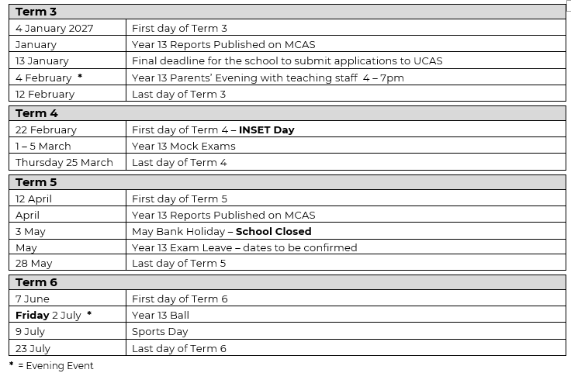
Please see the website to download or view the document

